Slide 1

HAMILTON Vector Software 4.1
Vector Database:
Architecture,
Benefits,
Functions,
Plus Version
March 16, 2007 / M. Hosang

Slide 2
Overview
Sample Tracking in v4.0
Sample Tracking in v4.1
Standard / Plus Version
Architecture
Database Model
Accessibility
Tracking
Filtering
Worklist Management

Slide 3
Sample Tracking in v4.0
Microsoft Access Database
One database per run
Limited HSL library functions
Limited to sample tracking functionality
No BVS tracking

Slide 4
Sample Tracking in v4.1
Vector Database
Microsoft SQL Server
Huge HSL library
Extended functionality
  BVS tracking
  Worklist management
  Reloading
2 versions: Standard & Plus

Slide 5
Standard / Plus Version
Standard Version: Part of the HAMILTON Vector Software v4.1
Plus Version: Additional Feature
  Support of Remote Database Servers
  Tracking over multiple Runs

Slide 6

Architecture
HSL Applications
Technology
  .net (C#, ADO.NET)
2 modules
  HxVectorDB
  HxDatabase
Supported DBMS
  Microsoft SQL Server
  Oracle (planned)
  PlugIns (planned)
COM Interfaces
HSL
Library
SQL
HxVectorDB
COM
Interfaces
other modules
HxDatabase
SQL
Vector Database
SQL
foreign
applications

Slide 7
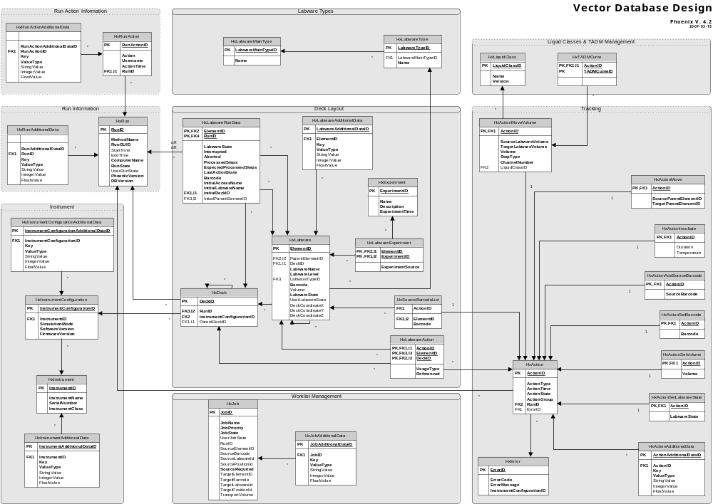
Database Model
RUN
DECK LAYOUT
TRACKING
WORKLIST

Slide 8
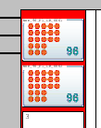


Database Model: Labware Mapping
Carrier: PLT_CAR_L5AC_A00_0001
Plate: Nun_96_Fl_LB_0001
Positions: A1 – H12

Slide 9
Accessibility
3 Main parts
  Tracking
  Worklist Mangement
  Filtering
Available via
  COM interfaces
  HSL libraries

Slide 10
Tracking
Tracking Devices
  Microlab STAR (incl Starlet & Plus)
  BVS
Tracking Actions
  Load / Unload
  Volume Moves
  Transports
  Custom Actions
Report Mapping File

Slide 11
Tracking in Detail
Each action manipulates at least the tables:
  HxLabwareRunData
  HxLabware
  HxLabwareAction
  HxAction
Per action specific data is stored in seperate tables
  HxActionMoveVolume, HxActionMove, etc

Slide 12
Worklist Management
Import of custom worklists
Automatic assigning of loaded labware to open jobs
Automatic sequence generating for jobs

Slide 13
Worklist Handling
Available Steps:
Import Worklist ¹⁾
Imports a worklist (Text, Excel or Access) into the Vector Database
Load and Match ²⁾
Loads Labware (samples or plates) and generates sequences/arrays based on the loaded labware and its matching worklist items
Update Sample Status ¹⁾
Sets the processing state for worklist items to processed. Only used if Load & Match is used multiple times within same run or worklist is used over multiple runs.
Legend:
¹⁾ Data Handling Steps
²⁾ Microlab Star Smart Steps

Slide 14
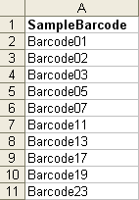
Worklist Handling: Example 1
Load sample tubes with barcode and process all samples which are in the worklist
Worklist:

Slide 15
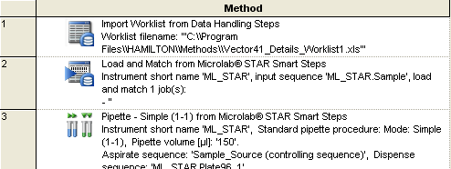
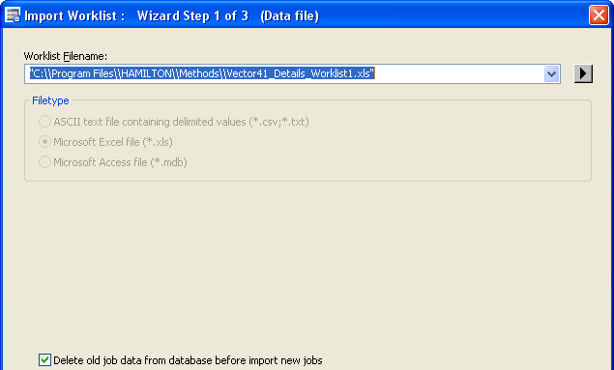
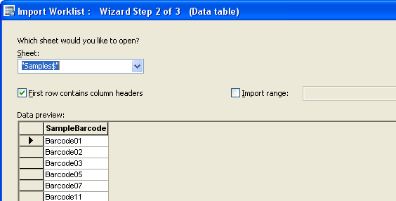
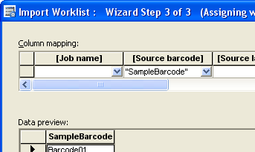
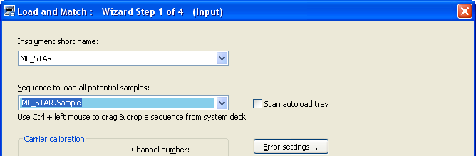
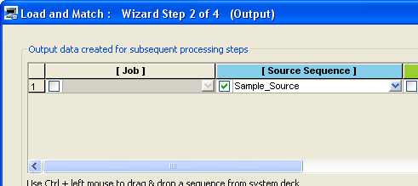
Worklist Handling: Example 1

Slide 16
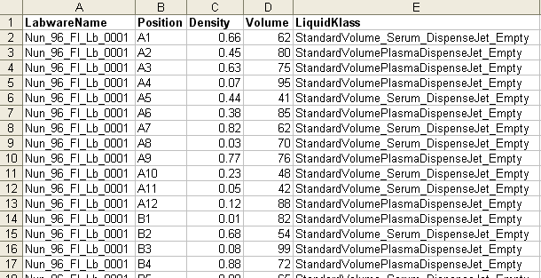
Worklist Handling: Example 2
Load plate and process all hits with a density greater than 0.6. Process each hit with an individual volume and liquid class.
Worklist:

Slide 17
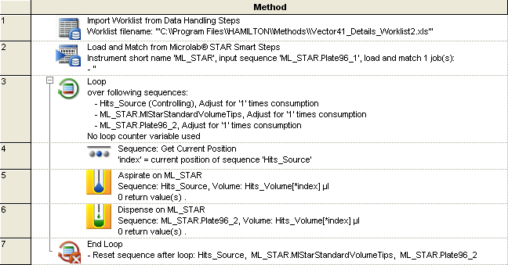
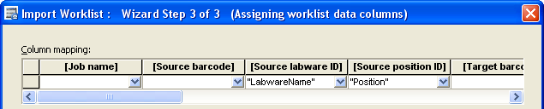
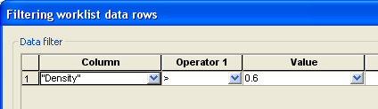
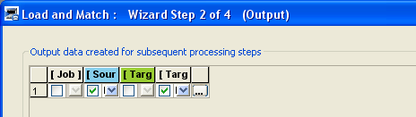


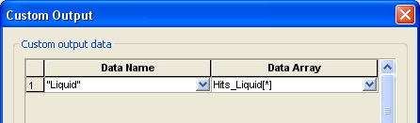
Worklist Handling: Example 2

Slide 18
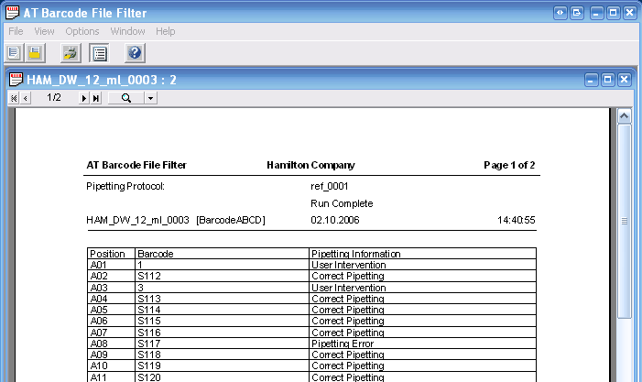
Filtering
AT Filter functionality

Slide 19
Vector Database Using Facts
The database represents always the current deck layout
A labware can be accessed via its ElementID all the time, even when its unloaded
A labware can be accessed via its labware access name as long as its loaded

